Slide 1
Nonprofit Business Model All nonprofits need a business model to thrive.
Co-sponsored by: Hartford Public Library &
Hartford Foundation for Public Giving
Presenter: Roosevelt Smith

Slide 2
Opening/Welcome

Slide 3
About Me
Roosevelt Smith
Roosevelt Smith has over twenty-eight years of rich and extensive experience in the nonprofit sector.
Consulting work has included large, small and volunteer-run nonprofit organizations in a wide array of mission areas such as youth development, housing, human services, human rights/social justice, environmental justice, food justice and arts.
Recovering ED – prior to starting consulting practice served for 15 years combined as a founding Executive Director for two nonprofits in Boston, MA.

Slide 4
Purpose & Agenda
The purpose of today’s workshop is to introduce you to the concept of a nonprofit business model, and how to use the Business Model Canvas framework to create a business model for your organization.
Agenda for Today
Opening & Welcome
Context
Definitions
Business Model Framework (Intro & Practice)
Wrap up

Slide 5
Current Situation

Slide 6
State of Nonprofits
1,365,00 is the approximate number of nonprofits registered with the IRS in 2019. (According to Publication 5331 [Rev. 7-2023])
Nonprofit Finance Fund (2022) State of Nonprofit Survey (1168 respondents)
Top 3 financial challenges:
73% of respondents struggle achieving long-term financial sustainability
66% of respondents struggle raising enough funds to cover the full costs of operations
65% of respondents struggle raising unrestricted funds
Top 3 staffing challenges:
55% employing enough staff
51% offering competitive pay
36% staff burnout

Slide 7
Framing Questions
What challenges are keeping you up at night?
Have you answered…
Why should donors, funders, or investors fund your organizations?
Why should the community, volunteers, stakeholders co-create change with you?
What is the social return or impact they can expect?
Every year you are expected to adapt, innovate, and come up with sustainable ways to fund your organization. How do you do that in an effective and efficient way?

Slide 8
Definition of Business Model

Slide 9
What is a sound business model?
It all begins with a viable business model.
Your business model should outline…
Who you are – your purpose (mission and vision), value –add agenda - unique contribution and scope of work (activities, services, programs and distinctiveness), and culture (values, norms and ways you organize yourselves to do what you do).
How you do your work – the key operating systems, structures, authority, workflow, policies and procedures that support your activities, services and programs; who you partner with and how you attract and deploy resources.
How do you finance your work – what is the true cost to operate and who is paying for it.

Slide 10
Tool & Framework

Slide 11
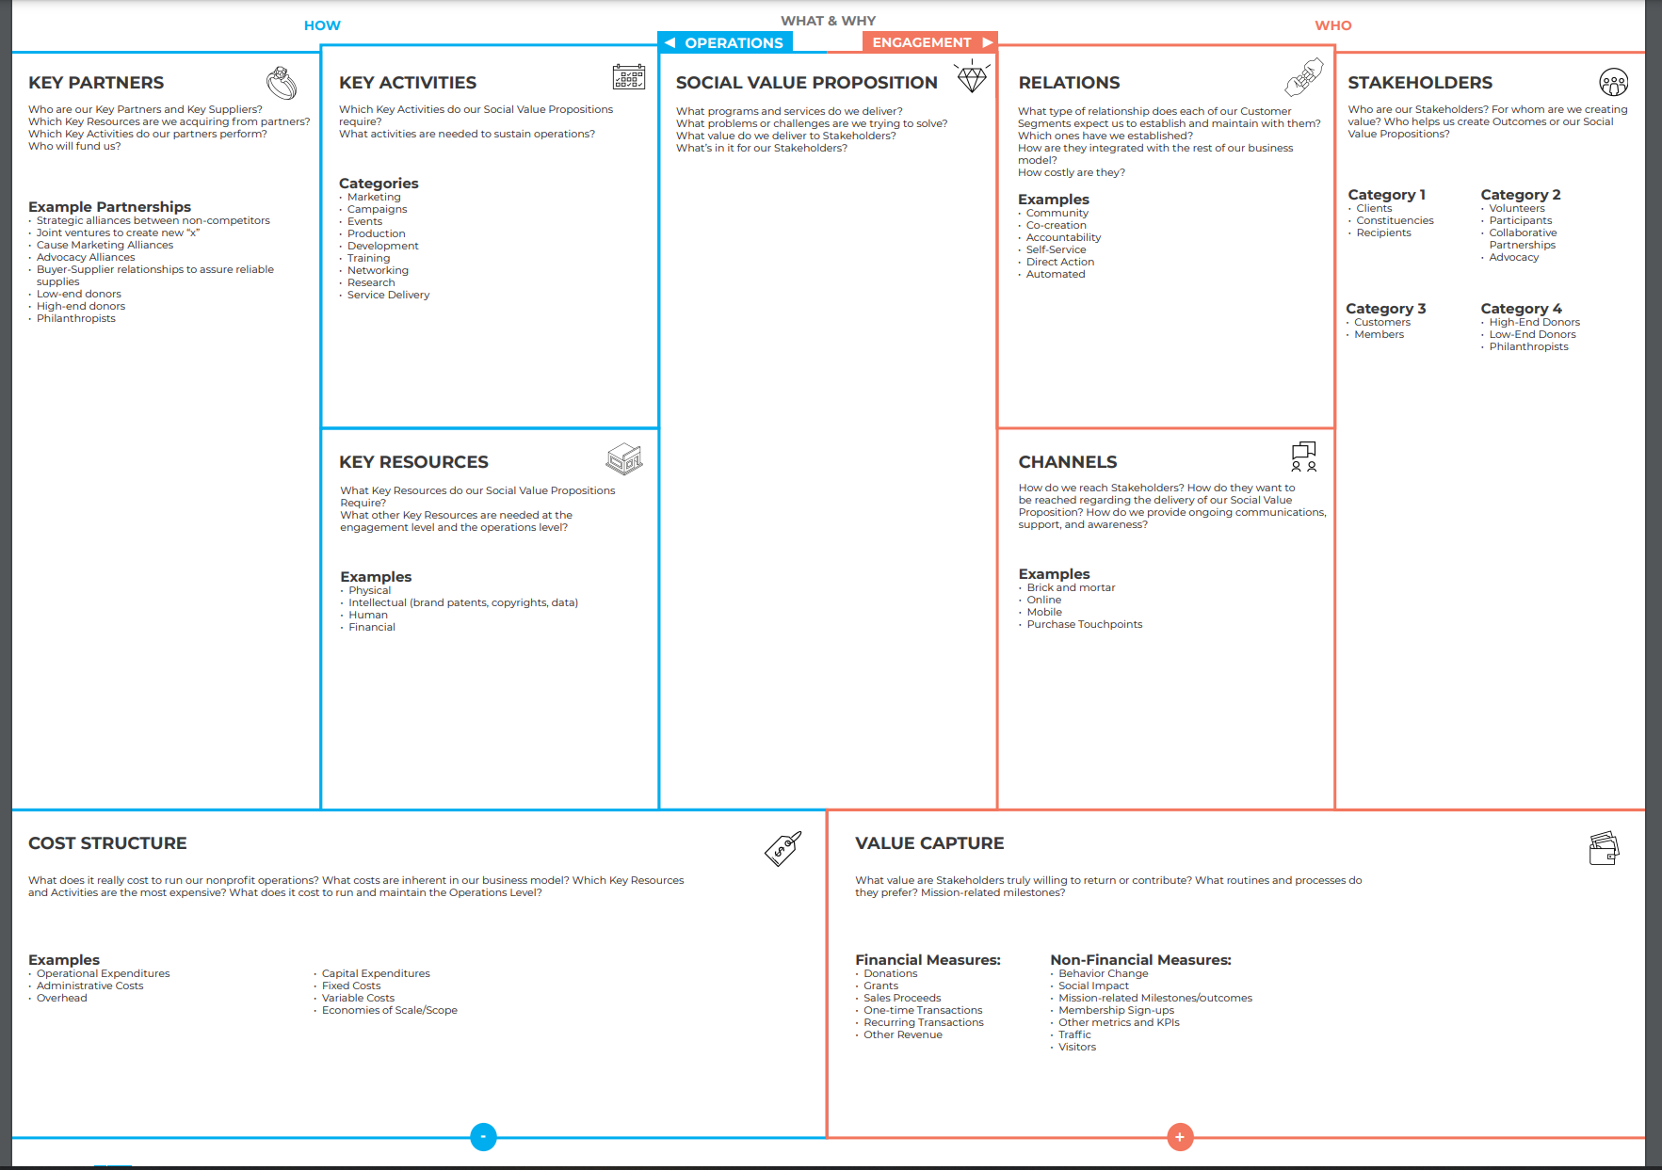
Nonprofit Business Model Canvas
The Nonprofit Business Model Canvas is a visual sensemaking tool that allows organizations to rapidly understand, test, and design a new way forward without waiting several months or years for the perfect plan.
It provides a blueprint for what to change, add, or subtract in your organization (in any given moment).
Made up of (9) nine key elements relatable to any nonprofit.
Notes:
Put Link in chat, ask people to open it up so that they can follow along.

Slide 12
Why this framework as a tool?
Visually shows how the nine elements connect and flow with one another.
Test assumptions - when you propose any change to your business model, you can visually see (play) with what impact that has on everything else in the organization.
You can imagine, experiment, and prototype multiple strategies around “what if ” and/or “how might we” scenarios differently than if you were just trying to vocalize them.
Saves time

Slide 13
Practice

Slide 14
Nonprofit Business Model Canvas Nonprofit Business Model Canvas NBMC Master Key (Handout) – Interactive Tool Nonprofit Canvas Link
Notes:
Pu

Slide 15
Practice
Look at together – explore 9 elements.
Practice generating “How might we…? (HMW’s)
Choose one of the 9 element blocks and generate as many “how might we questions” in five minutes.
Share back
Alternative questions building off HMW’s – Why? Or What’s stopping.

Slide 16
Business Model Canvas Steps Summary
Collectively fill out the canvas
Generate HMW questions from initial facts (why or what’s stopping you?)
Build consensus on priority areas to focus on
Discuss and make connections (prototype)
Create ideas and action steps
Role up into an annual workplan or other type of plan (marketing, communications, funds development, overarching business plan, etc.)

Slide 17
Wrap Up

Slide 18
Closing
Summary of today’s session
Additional questions you have?
Please complete survey
Thank you!
HPL/HFPG Close Out.

Slide 19
Resource Page
Nonprofit Canvas Link
https://www.irs.gov/pub/irs-pdf/p5331.pdf
https://nff.org/learn/survey

